Slide 1
Chapter 4
Shell Scripting
Notes:
sudo apt update && sudo apt upgrade -y

Slide 2
At the end of this lesson, students will be able to:
Understand the role and importance of shell scripting in Linux.
Identify basic syntax and commands used in shell scripts.
Write and execute basic shell scripts.
Apply scripting to automate simple system tasks

Slide 3
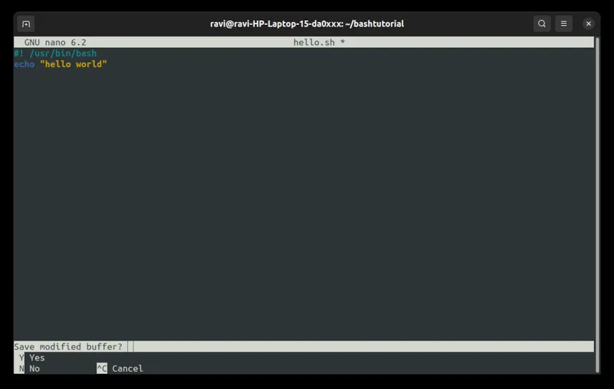
What is Shell Scripting?
Shell scripting is writing a series of Linux commands in a file to be executed like a program.
Notes:
The shell (like Bash) acts as a command interpreter. Instead of typing commands one-by-one, you write them in a file (e.g., script.sh) and execute it to automate tasks like backups, file management, or software installations.

Slide 4
Why Use Shell Scripts?
Automate repetitive tasks
Save time and reduce human error
Perform system administration
Schedule cron jobs
Notes:
Shell scripts are widely used by developers and sysadmins to perform tasks like daily backups, package installations, user account setup, or even deploying apps automatically.

Slide 5
Basic Scripting Concepts
Shebang (#!/bin/bash): Tells the OS to use Bash to run the script.
Comments (#): Add notes in your code.
Variables: name="Jerico"
Echo: Output something → echo "Hello, $name"
Notes:
The shebang is always the first line. Comments are ignored by the shell but helpful for documentation. Variables store data, and echo displays output.

Slide 6
Writing Your First Script
#!/bin/bash
name="Jerico"
echo "Hello, $name! Welcome to scripting."
How to run it:
chmod +x hello.sh
./hello.sh
Notes:
chmod +x hello.sh
./hello.sh
You give the script execute permission using chmod +x. Then run it with ./. This script prints a greeting using a variable.

Slide 7
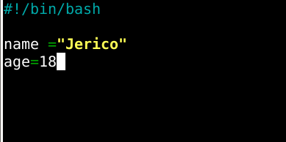
Basic Shell Scripting (Variables)

Slide 8
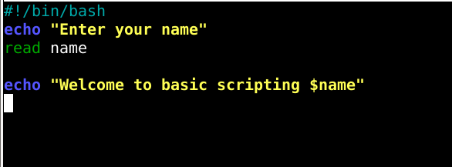
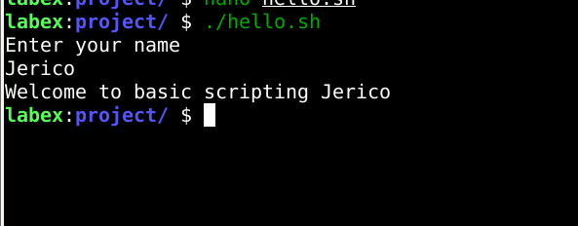
Basic Shell Scripting (Output and Input)

Slide 9
Basic Shell Scripting (Comparison Operators)
Operator | Meaning | Example
-eq | Equal to | [ 5 -eq 5 ]
-ne | Not equal to | [ 5 -ne 3 ]
-gt | Greater than | [ 6 -gt 5 ]
-lt | Less than | [ 4 -lt 5 ]
-ge | Greater than or equal to | [ 5 -ge 5 ]
-le | Less than or equal to | [ 4 -le 5 ]

Slide 10
Basic Shell Scripting (Logical Operators)
Operator | Meaning | Example
&& | AND (both must be true) | if [ $age -ge 18 ] && [ $filipinocitizen = “yes" ]
|| | OR (atleast one is true ) | if [ $age -ge 18 ] || [ "$permit" = "yes" ]
! | NOT (negates condition) | if [ ! -f file.txt ] → true if file doesn't exist
Notes:
-f is used to check if a file exists and is a regular file (not a directory or special file).

Slide 11
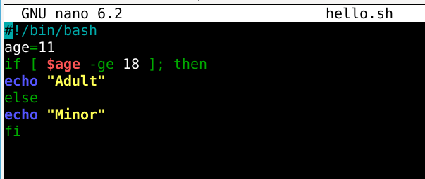
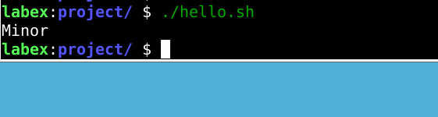
Basic Shell Scripting (if else Statement)

Slide 12
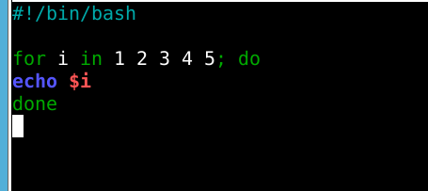
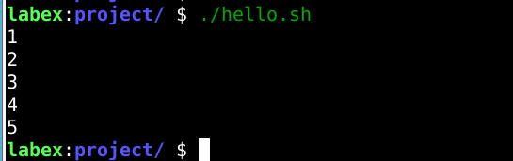
Basic Shell Scripting (Loops)
-For loop
Notes:
It always in on done

Slide 13
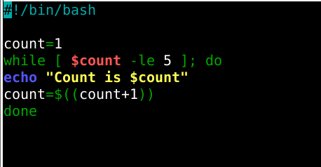
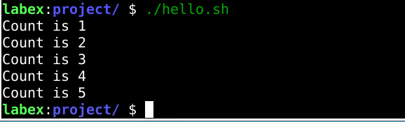
Basic Shell Scripting (Loops)
-while loop
Notes:
It always in on done

Slide 14
Basic Shell Scripting (Loops)
-while loop
Notes:
It always in on done

Slide 15
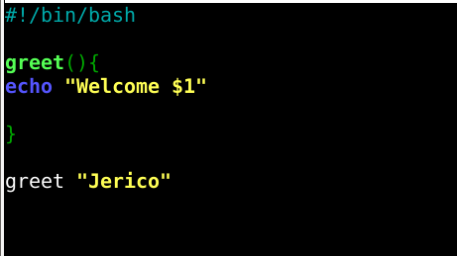

Basic Shell Scripting (Function)
Notes:
It always in on done echo "Good day, $1!"echo prints the message to the terminal. $1 refers to the first argument passed to the function.
$1 is a positional parameter used to get arguments inside functions.

Slide 16
Hands On
Use Case: Automatically back up a folder.
Notes:
#!/bin/bash
src="/home/user/documents"
dest="/home/user/backup_$(date +%F)"
mkdir -p "$dest"
cp -r "$src"/* "$dest"
echo "Backup completed to $dest"

Slide 17
Thank You
Notes:
sudo apt update && sudo apt upgrade -y

